Slide 1

AIR BNB CASE STUDY PPT 1
By: Pallavi Bothra
Priyanka Swain
Pritam Panchal
(DSC-58)

Slide 2
Context
Problem Statement
End Objective
Insights
Recommendations
Methodology

Slide 3

Problem Statement
Airbnb, Inc. is a leading American corporation facilitating an online platform connecting travellers with diverse lodging options, including homestays for vacation rentals, and a range of tourism experiences.
Airbnb has seen a major decline in revenue. Now that the restrictions have started lifting and people have started to travel more. Airbnb wants to make sure that it is fully prepared for this change.

Slide 4
End Objective
To strategize post-COVID-19 landscape and comprehensively understand current customer sentiments and desires.
Develop a robust long-term business strategy that aligns with evolving customer expectations & revenue optimization.

Slide 5

Insights

Slide 6
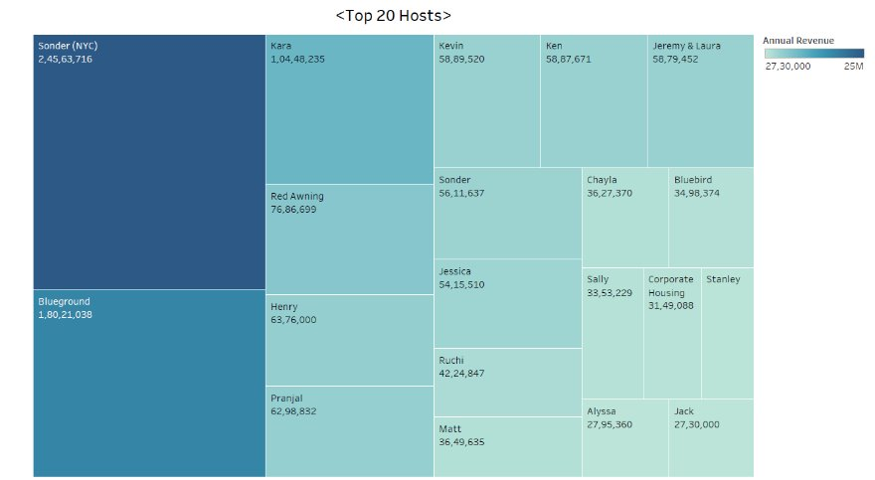
Top 20 Hosts based on Annual Revenue
Sonder NYC & Blueground are the top hosts followed by Kara among all the neighborhood groups.
There is more scope to grow in these Regions as they have the highest annual revenue.

Slide 7
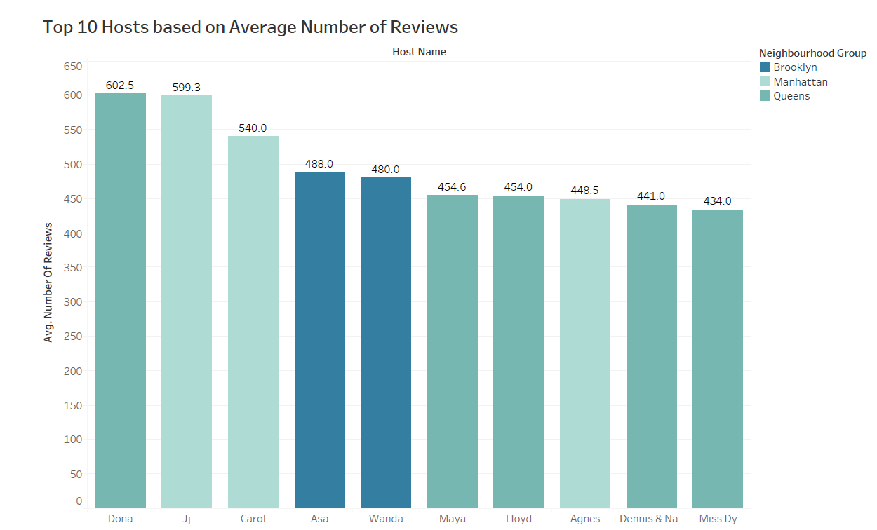
Dona from Queens & Jj & Carol from Manhattan are the top 3 hosts based on reviews.
Their experiences could be examined & can be implemented by others hosts.

Slide 8
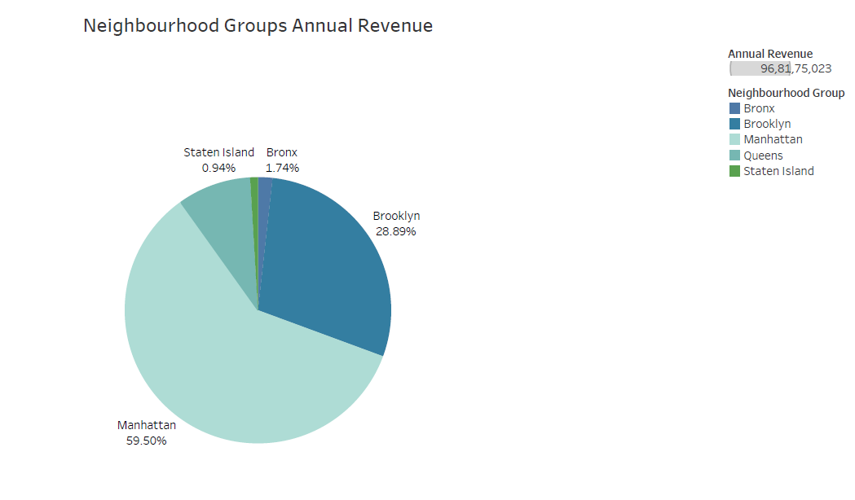
Top Neighbourhood Groups based on Annual Revenue
Manhattan & Brooklyn hold the maximum share of revenue among all the neighbourhood groups. This segment should be optimized to its fullest potential to achieve revenue targets.

Slide 9
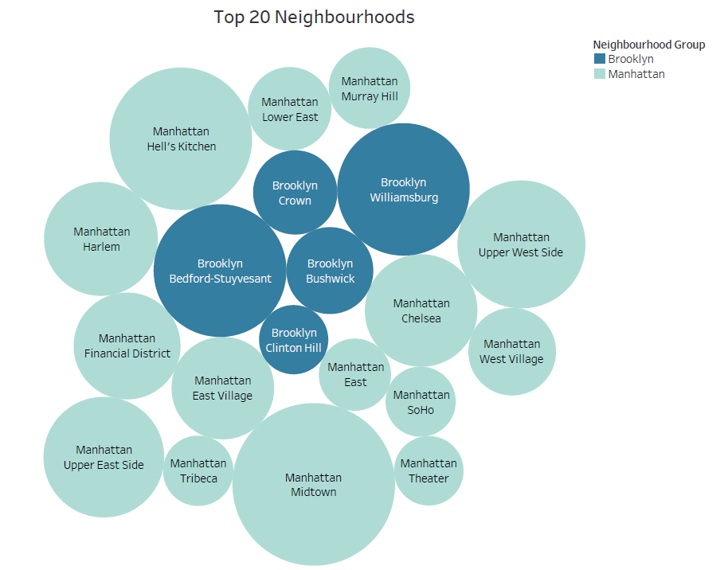
Top 20 Neighbourhoods
Bedford-Stuyvesant, Midtown & Williamsburg are the top neighbourhoods.

Slide 10
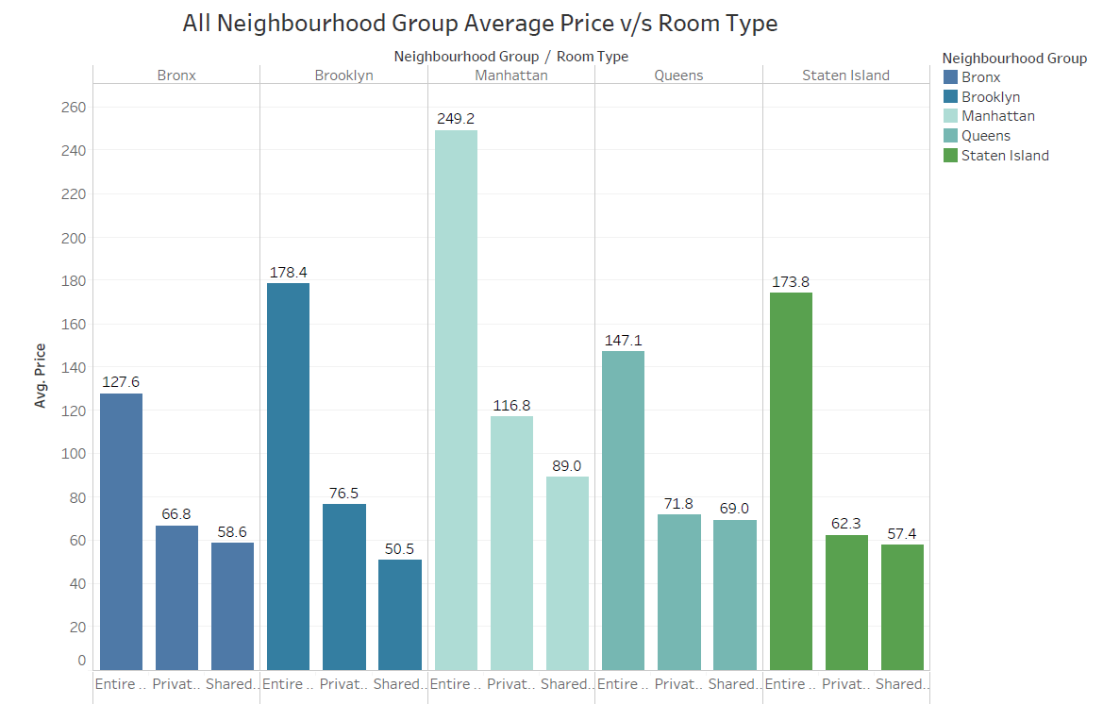
All Neighbourhood Group Average Price v/s Room Type
Manhattan & Brooklyn have the highest average prices for Entire home/apt & Private Rooms.

Slide 11
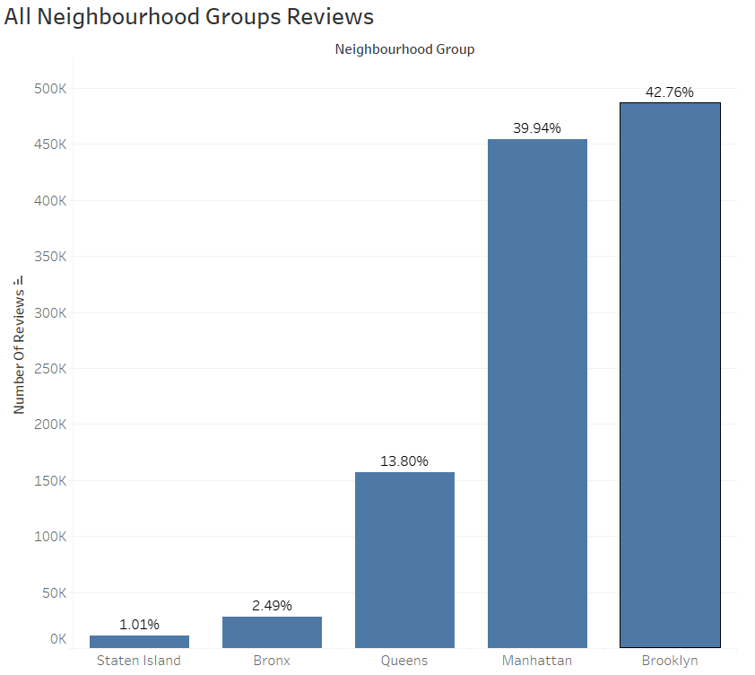
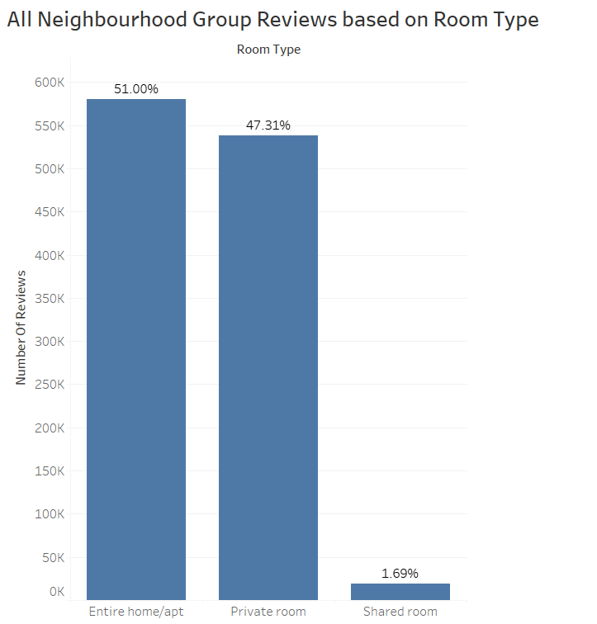
Manhattan and Brooklyn have the highest group reviews.
Most of the group reviews are for Entire home/apt and Private rooms.

Slide 12
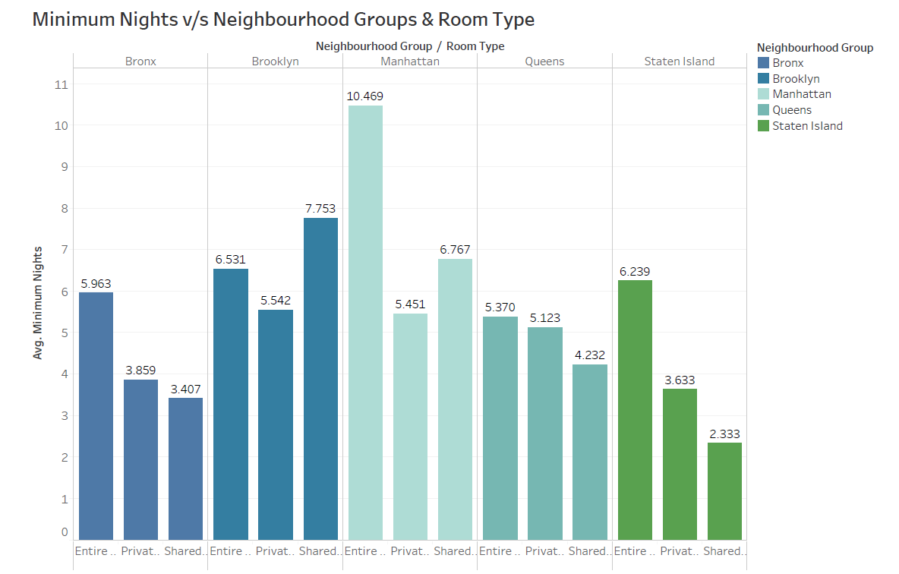
Minimum Nights spent are highest for Manhattan in Entire Home/apt followed by Shared Rooms.
In Brooklyn Shared Rooms have the highest minimum nights.

Slide 13

Recommendations
Manhattan & Brooklyn are the top neighbourhood groups generating highest revenue and top reviews, but the average prices could be planted more competitively to attract more customers.
Entire Home/Apt & Private Rooms have high number of reviews, but the minimum night's stay are more for shared rooms. We can see that customers are inclined towards shared rooms for longer stay, this segment should be targeted and promoted.
The experiences of the top hosts could be examined & can be implemented by others hosts as well to gain more footfall and better customer experience.

Slide 14
Methodology
Data Cleaning in Excel (Handling Missing Values & Data Types)
Data Visualization & Analysis in Tableau (on Price, Room Type, Neighbourhood and Neighbourhood Groups, Hosts, Minimum Nights, etc)

